Slide 1
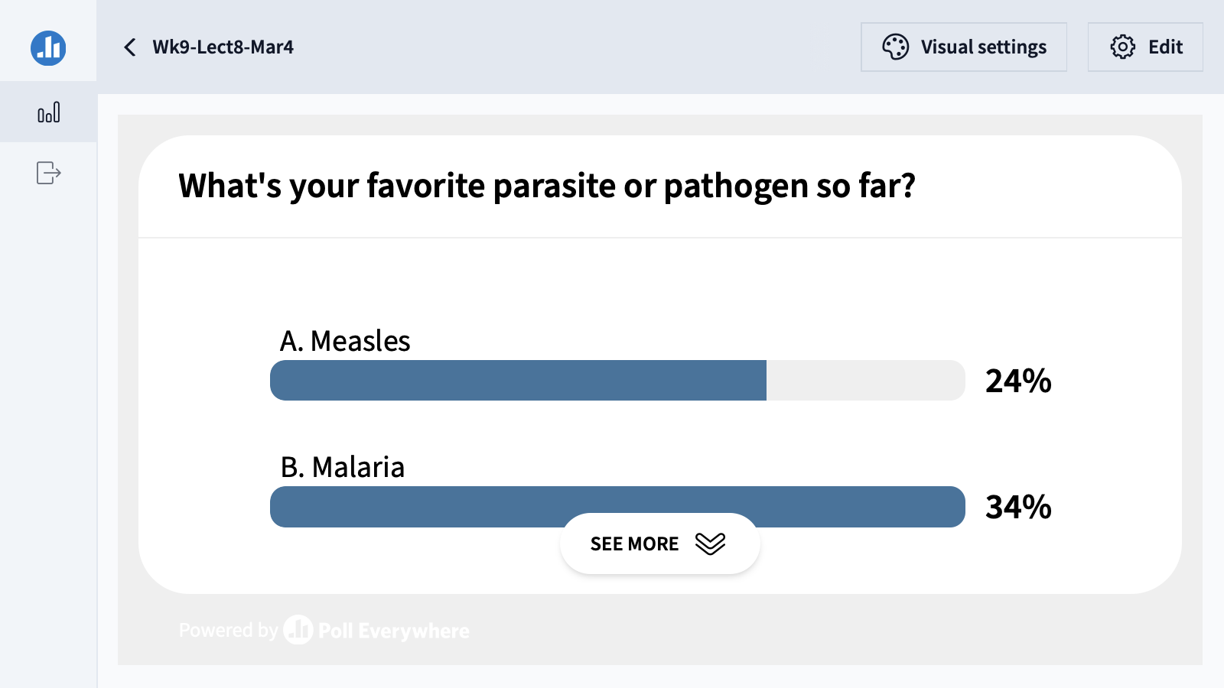

Slide 2
Fundamentals of Ecology
Week 9, Ecology Lecture 8
Cara Brook
March 3, 2025
Office hours: On ZOOM
Thursday, March 6, 2025
4-5pm
I will email out a link!

Slide 3
Learning objectives from Lecture 7
You should be able to:
Understand the relationship between herd immunity and R0
Understand the direction of time in a disease epidemic from a phase plane graph (from lab)
Know the two global vaccination success stories and be able to list some of the challenges to vaccination in other cases
Know the term ‘critical community size’
Recognize different types of pathogen transmission and acknowledge that unique approaches are needed capture this transmission in a model
Given a model diagram, recognize if the disease is transmitted directly or has a vector or animal reservoir

Slide 4
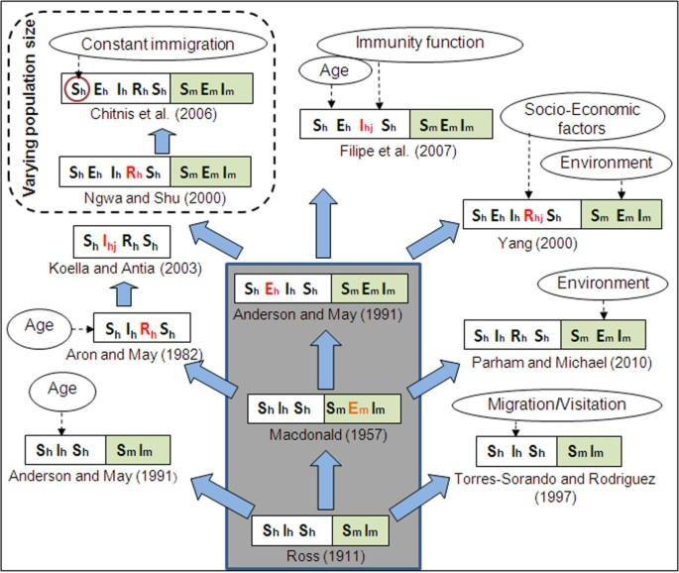
Malaria models have played a critical role in public health policy for over a century.
1911: British medical Dr. Sir Ronald Ross developed the first model of malaria while working in the Indian Medical Service.
1957: MacDonald modified this model to include the latent period of the parasite in the mosquito.
This led to a widespread WHO campaign for malaria elimination using DDT in the 1950s!
1991: Anderson and May extended model to show latency in the human population.
Mandal et al. 2011. Malaria Journal.

Slide 5
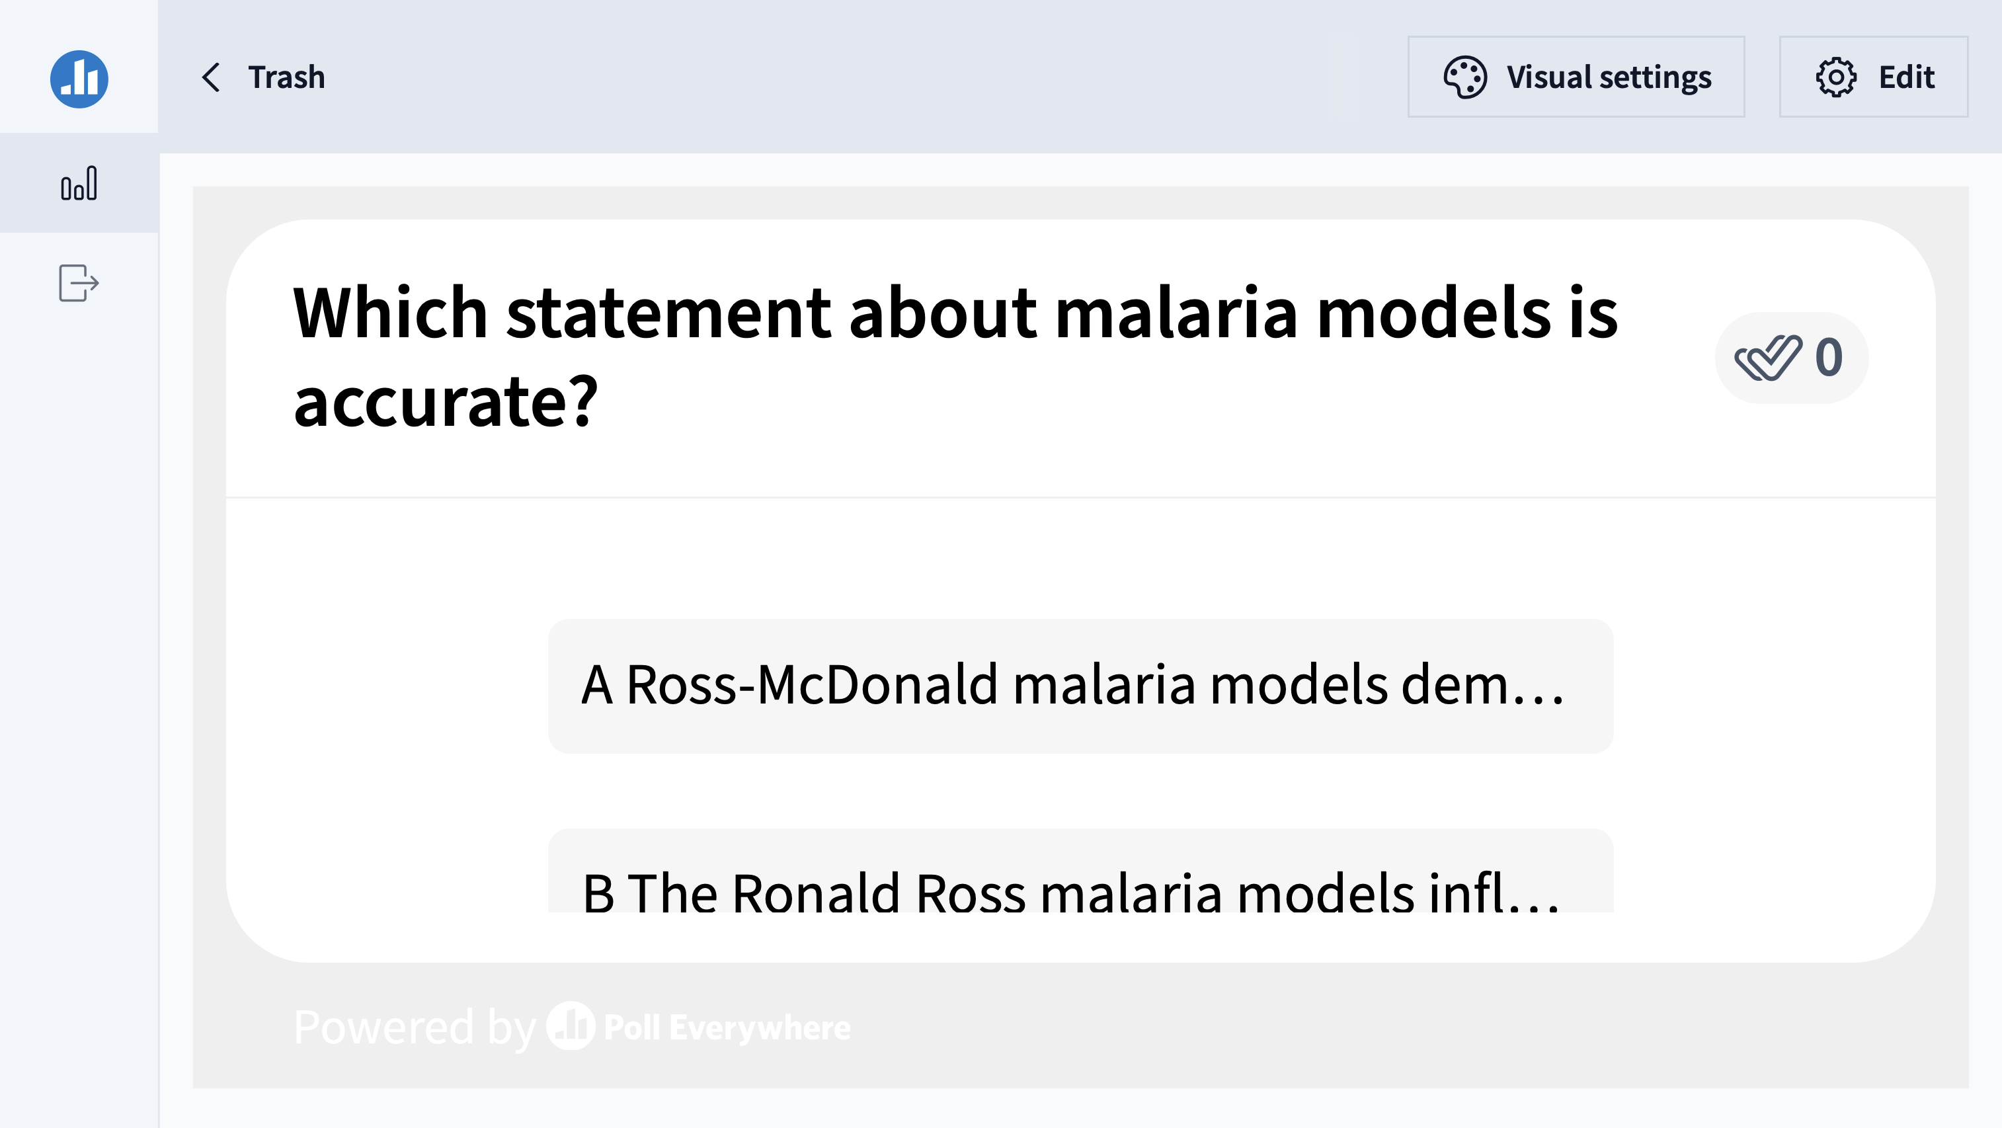

Slide 6
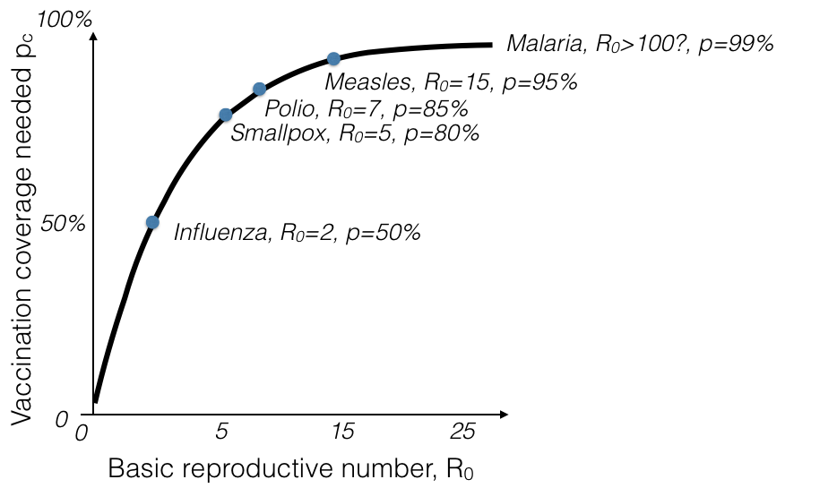
Challenges to malaria elimination
High parasite diversity: sexual reproduction in 4+ Plasmodium species
Fast evolution of resistance (e.g. to drugs)
Many possible vectors! Potentially additional possible reservoirs!
Latent cases as burden is reduced
Vaccine candidates: what life stage to target?
Herd immunity threshold (HIT)

Slide 7
Challenges to malaria elimination
High parasite diversity: sexual reproduction in 4+ Plasmodium species
Fast evolution of resistance (e.g. to drugs)
Many possible vectors! Potentially additional possible reservoirs!
Latent cases as burden is reduced
Vaccine candidates: what life stage to target?
Herd immunity threshold (HIT)

Slide 8
Challenges to malaria elimination
High parasite diversity: sexual reproduction in 4+ Plasmodium species
Fast evolution of resistance (e.g. to drugs)
Many possible vectors! Potentially additional possible reservoirs!
Latent cases as burden is reduced
Vaccine candidates: what life stage to target?
Herd immunity threshold (HIT)

Slide 9
Challenges to malaria elimination
High parasite diversity: sexual reproduction in 4+ Plasmodium species
Fast evolution of resistance (e.g. to drugs)
Many possible vectors! Potentially additional possible reservoirs!
Latent cases as burden is reduced
Vaccine candidates: what life stage to target?
Herd immunity threshold (HIT)

Slide 10
Challenges to malaria elimination
High parasite diversity: sexual reproduction in 4+ Plasmodium species
Fast evolution of resistance (e.g. to drugs)
Many possible vectors! Potentially additional possible reservoirs!
Latent cases as burden is reduced
Vaccine candidates: what life stage to target?
Herd immunity threshold (HIT)

Slide 11
Pathogens exhibit diverse transmission mechanisms that require tailored modeling structures
Vector-borne diseases (a type of indirect transmission) are transmitted via blood-feeding arthropod (mosquitoes, ticks, fleas)
Malaria: Mosquito-borne protozoan Plasmodium spp.
“Arboviruses”: Mosquito-borne viruses, including Dengue, Zika, Yellow fever virus, West Nile virus, Chikungunya virus
Sleeping sickness, also known as African trypanosomiasis: tsetse fly vector and protozoan pathogen (trypanosome)
Chagas disease: kissing bug vector and trypanosome pathogen
Plague: flea vector and bacterial pathogen (Yersinia pestis)
Notes:
Kissing bugs = hemiptera = true bugs

Slide 12
Pathogens exhibit diverse transmission mechanisms that require tailored modeling structures
Vector-borne diseases (a type of indirect transmission) are transmitted via blood-feeding arthropod (mosquitoes, ticks, fleas)
Malaria: Mosquito-borne protozoan Plasmodium spp.
“Arboviruses”: Mosquito-borne viruses, including Dengue, Zika, Yellow fever virus, West Nile virus, Chikungunya virus
Sleeping sickness, also known as African trypanosomiasis: tsetse fly vector and protozoan pathogen (trypanosome)
Chagas disease: kissing bug vector and trypanosome pathogen
Plague: flea vector and bacterial pathogen (Yersinia pestis)
Plague is BOTH vector-borne and zoonotic!
Notes:
Kissing bugs = hemiptera = true bugs

Slide 13


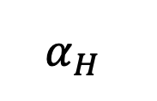
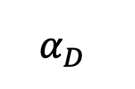
Zoonoses are pathogens transmitted from a wildlife reservoir to a spillover human host.
μ_{D}
μ_{D}
wildlife reservoir
b_{D}
β_{D}
S_{D}
I_{D}
$$α_{D}$$
direction of transmission
b_{H}
S_{H}
β_{H}
I_{H}
$$α_{H}$$
spillover human host
μ_{H}
μ_{H}
ex: rabies
Haydon et al. 2002. Emerging Infectious Diseases.

Slide 14
Zoonoses are pathogens transmitted from a wildlife reservoir to a spillover human host.
μ_{D}
μ_{D}
wildlife reservoir
b_{D}
β_{D}
S_{D}
I_{D}
$$α_{D}$$
Typically modeled with the reservoir as a distinct state variable!
direction of transmission
b_{H}
S_{H}
β_{H}
I_{H}
$$α_{H}$$
spillover human host
μ_{H}
μ_{H}
ex: rabies
Haydon et al. 2002. Emerging Infectious Diseases.

Slide 15
Zoonoses are pathogens transmitted from a wildlife reservoir to a spillover human host.
The reservoir host must be able to independently maintain the pathogen, with population size > CCS!
μ_{D}
μ_{D}
wildlife reservoir
b_{D}
β_{D}
S_{D}
I_{D}
$$α_{D}$$
direction of transmission
b_{H}
S_{H}
β_{H}
I_{H}
$$α_{H}$$
spillover human host
μ_{H}
μ_{H}
Animal hosts are not vectors!
ex: rabies
Haydon et al. 2002. Emerging Infectious Diseases.

Slide 16


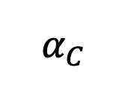
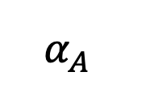
Spillover is the term used to describe pathogen transmission between any two different species.
μ_{A}
μ_{A}
reservoir
b_{A}
β_{A}
S_{A}
I_{A}
$$α_{A}$$
direction of transmission
b_{C}
S_{C}
β_{C}
I_{C}
$$α_{C}$$
spillover host
μ_{C}
μ_{C}
ex: avian flu

Slide 17
Spillover is the term used to describe pathogen transmission between any two different species.
μ_{A}
μ_{A}
reservoir
b_{A}
β_{A}
S_{A}
I_{A}
$$α_{A}$$
A zoonosis always requires spillover, but a spillover does not necessarily mean a zoonosis!
direction of transmission
b_{C}
S_{C}
β_{C}
I_{C}
$$α_{C}$$
spillover host
μ_{C}
μ_{C}
ex: avian flu

Slide 18


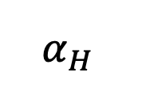
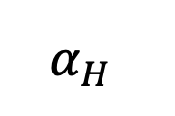
Spillback is the term used to describe pathogen transmission back to a reservoir host from a spillover host.
μ_{H}
μ_{H}
reservoir
b_{H}
β_{H}
S_{H}
I_{H}
$$α_{H}$$
direction of transmission
b_{H}
S_{H}
β_{H}
I_{C}
$$α_{H}$$
spillover host
mink
μ_{H}
μ_{H}
ex: SARS-CoV-2

Slide 19
Spillback is the term used to describe pathogen transmission back to a reservoir host from a spillover host.
μ_{H}
μ_{H}
reservoir
b_{H}
Interesting case because neither humans nor mink are the original reservoir host!
β_{H}
I_{H}
$$α_{H}$$
S_{H}
direction of transmission
b_{H}
S_{H}
β_{H}
I_{C}
$$α_{H}$$
spillover host
mink
μ_{H}
μ_{H}
ex: SARS-CoV-2

Slide 20

Spillback is the term used to describe pathogen transmission back to a reservoir host from a spillover host.
μ_{H}
μ_{H}
reservoir
b_{H}
β_{H}
S_{H}
I_{H}
$$α_{H}$$
direction of transmission
b_{H}
S_{H}
β_{H}
I_{C}
$$α_{H}$$
spillover host
μ_{H}
μ_{H}
ex: Yellow Fever in the Americas

Slide 21


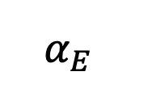
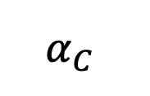
Spillback occurs among wildlife as well.
μ_{C}
μ_{C}
reservoir
b_{C}
β_{C}
S_{C}
I_{C}
$$α_{C}$$
direction of transmission
b_{E}
S_{E}
β_{E}
I_{E}
$$α_{E}$$
spillover host
μ_{E}
μ_{E}
ex: Brucella spp. in Yellowstone National Park

Slide 22
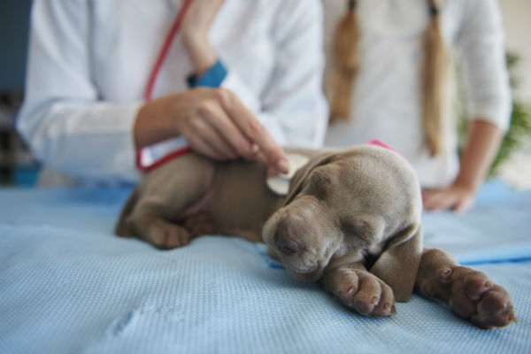
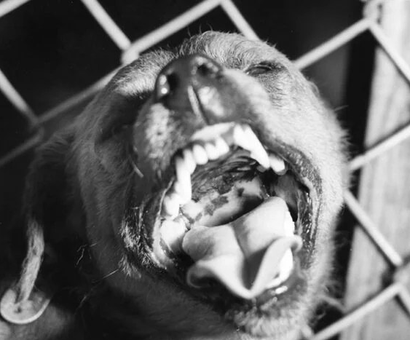
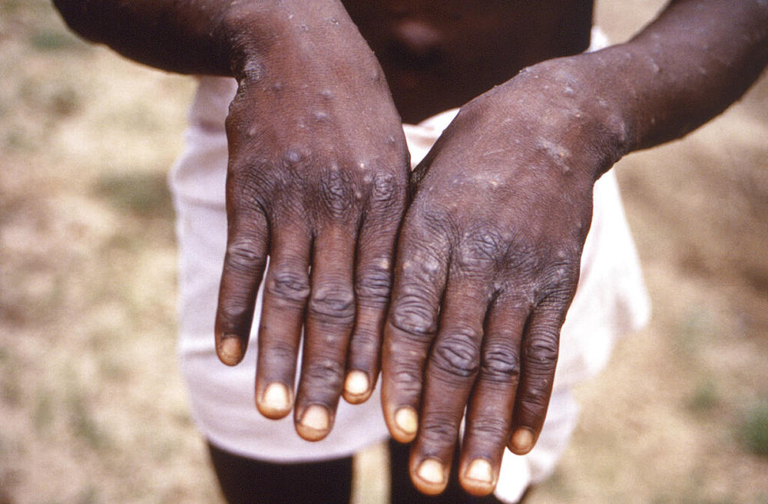
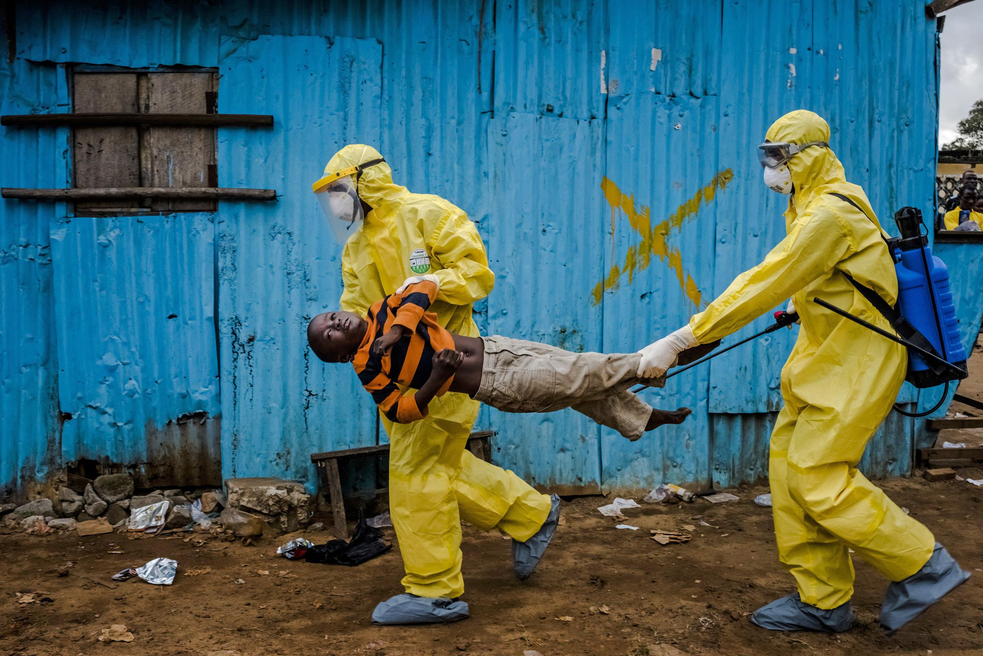
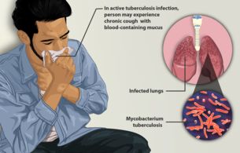
Pathogens can be classed according to their host relationships.
Stage I
Stage II
Stage III
Stage IV
Stage V
Transmits exclusively in humans
Transmits exclusively in animals
Human cases from spillovers only
Stuttering chains of transmission in humans
Sustained transmission and human outbreaks
canine parvovirus
rabies virus
monkeypox (pre-2022)
Ebola virus (especially post-2014)
Tuberculosis
Lloyd-Smith et al. 2009. Science.

Slide 23
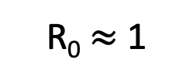
Pathogens can be classed according to their host relationships.
Stage I
Stage II
Stage III
Stage IV
Stage V
Transmits exclusively in humans
Transmits exclusively in animals
Human cases from spillovers only
Stuttering chains of transmission in humans
Sustained transmission and human outbreaks
canine parvovirus
rabies virus
monkeypox (pre-2022)
Ebola virus (especially post-2014)
Tuberculosis
R₀ < 1
R₀ $≈$ 1
R₀ > 1
Zoonotic pathogens can be classed according to their R₀ in humans.
Lloyd-Smith et al. 2009. Science.

Slide 24
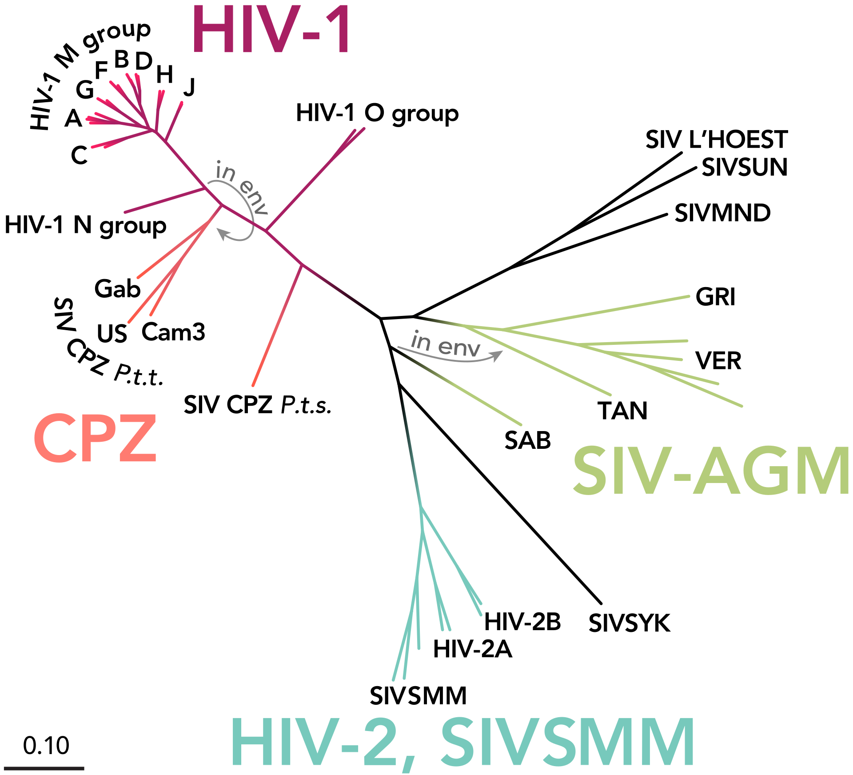
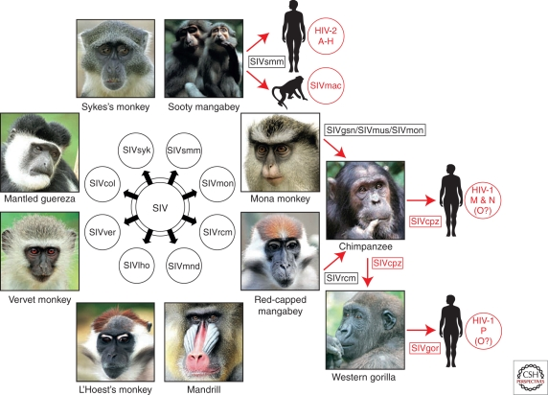
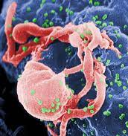
Most stage V pathogens once had an animal origin, as well!
Stage V
Transmits exclusively in humans
HIV
Sharp & Hahn. 2011. Cold Spring Harb Perspect Med.

Slide 25
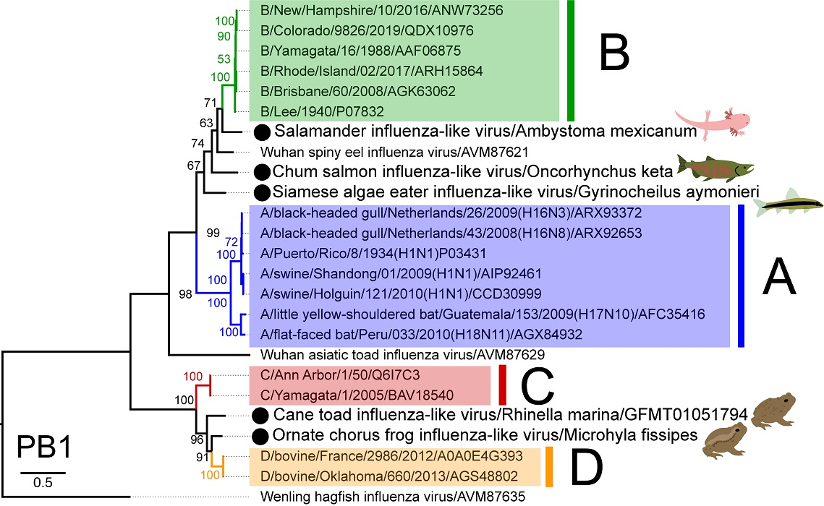
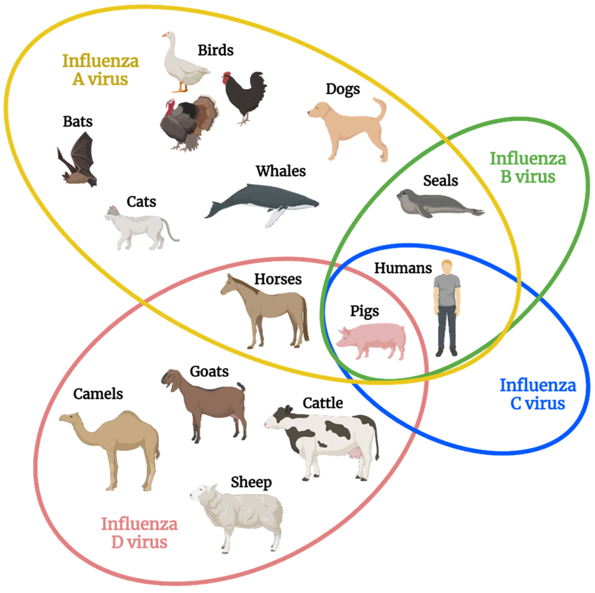
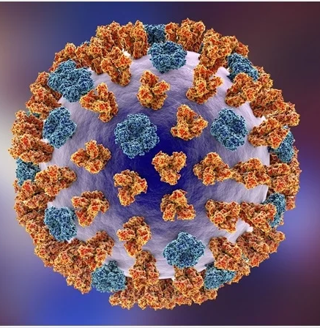
When is influenza zoonotic?
Parry et al. 2020. Viruses.
Transmits exclusively in humans
Stage V
Influenza
Skelton & Huber. 2022. Viruses.

Slide 26
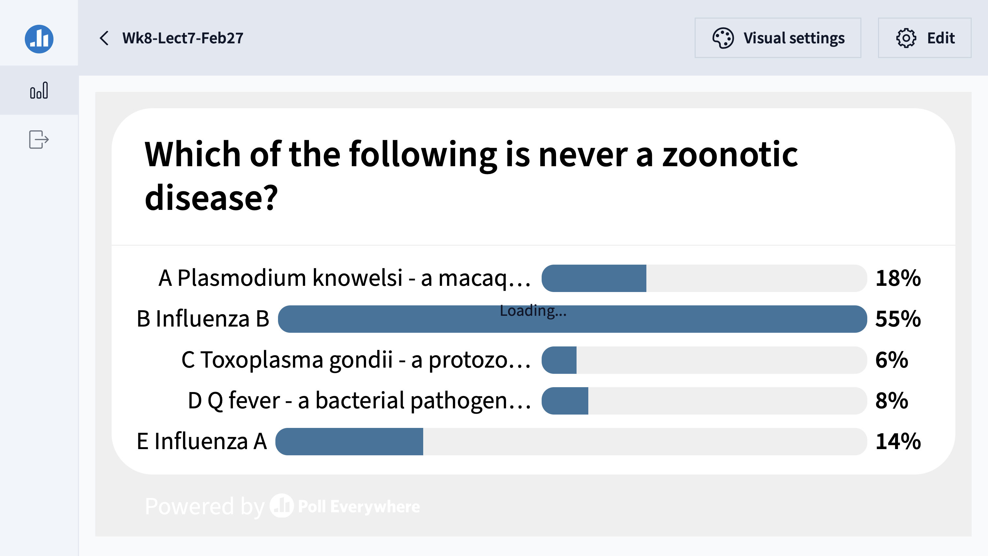

Slide 27
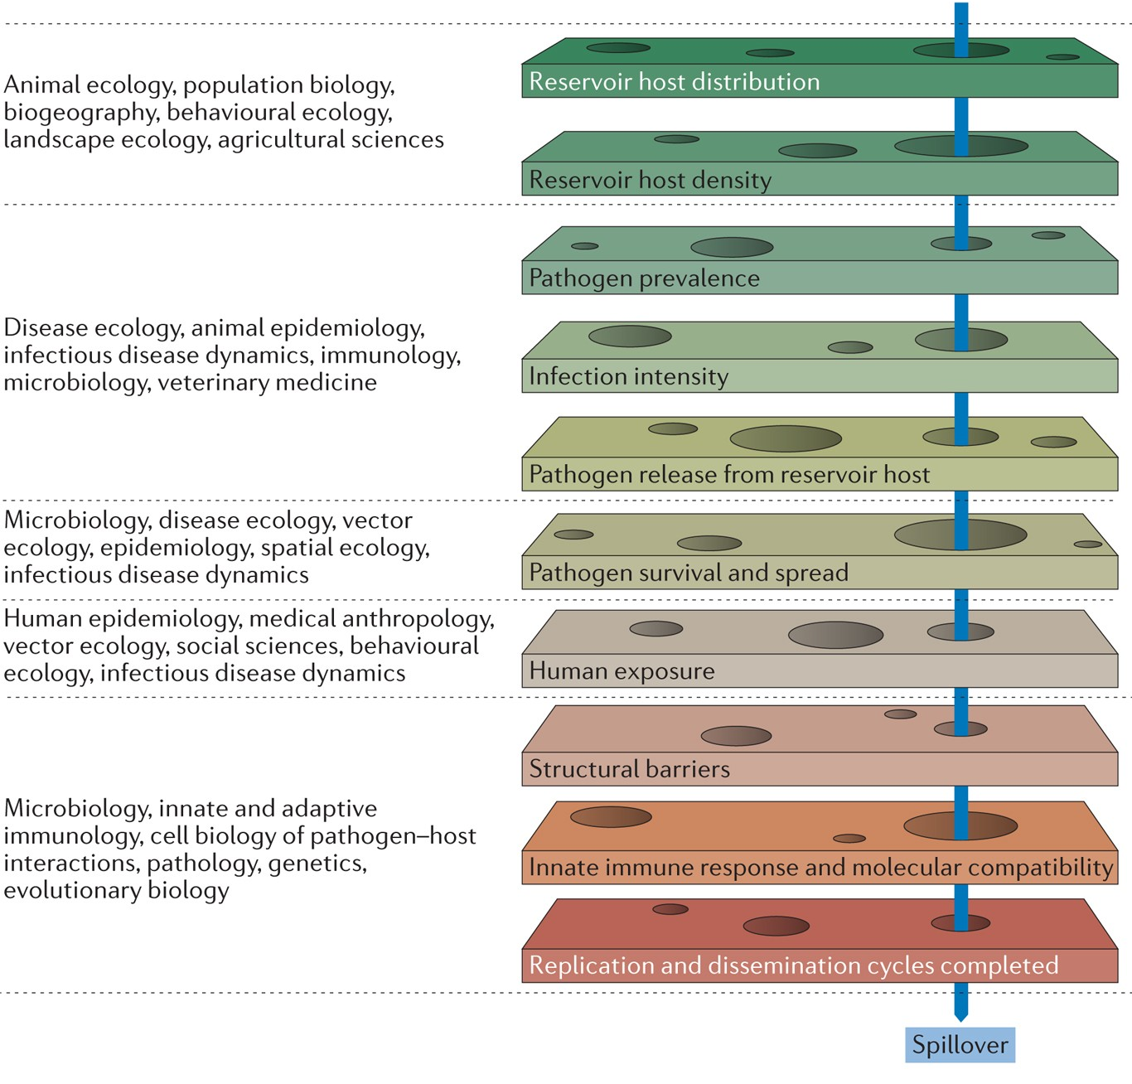
There are many barriers to cross-species transmission.
We can think of zoonosis as a series of improbable events multiplied together.
Plowright et al. 2017. Nature Reviews Microbiology.

Slide 28
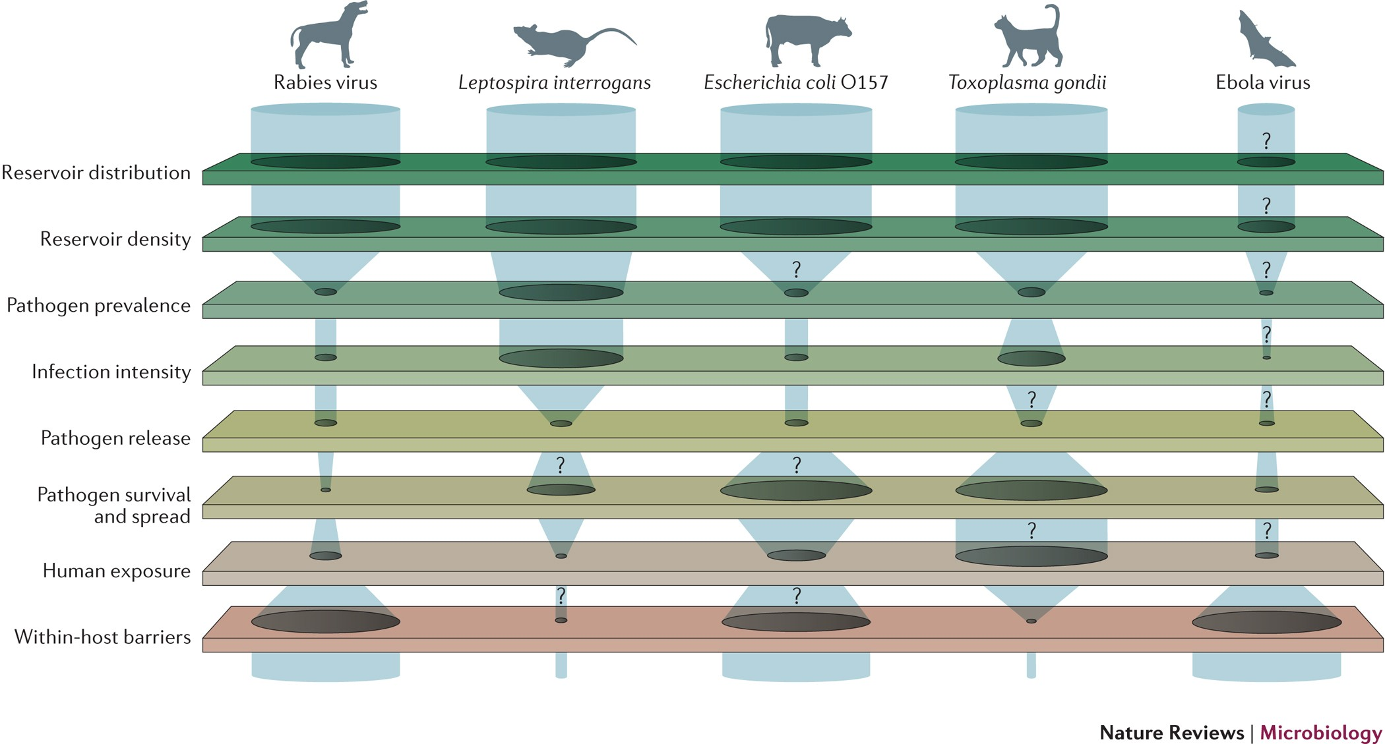
Bottlenecks to zoonotic transmission vary for different pathogens.
Plowright et al. 2017. Nature Reviews Microbiology.

Slide 29
Why do pathogens make us sick?

Slide 30

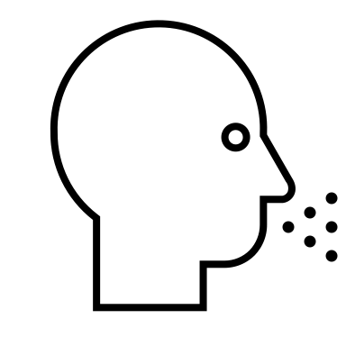

Why do pathogens make us sick?
A virus will evolve to maximize its capacity for between-host infections (R₀).
Alizon et al. 2008. J Evolutionary Biology
Anderson and May 1982. Parasitology.
Notes:
Typically, we predict that a virus will evolve traits that maximize its capacity for reproducing itself by infecting new hosts, achieving a baseline viral density within a single individual that produces sufficient virions in excretia – like the cough shown here – to go on to infect new hosts

Slide 31

Why do pathogens make us sick?
A virus will evolve to maximize its capacity for between-host infections (R₀).
$$β$$
transmission
Alizon et al. 2008. J Evolutionary Biology
Anderson and May 1982. Parasitology.
Notes:
Typically, we predict that a virus will evolve traits that maximize its capacity for reproducing itself by infecting new hosts, achieving a baseline viral density within a single individual that produces sufficient virions in excretia – like the cough shown here – to go on to infect new hosts

Slide 32
Why do pathogens make us sick?
A virus will evolve to maximize its capacity for between-host infections (R₀).
$$α$$
virulence
$$β$$
transmission
Mechanisms that promote transmission may also enhance virulence to the host.
Alizon et al. 2008. J Evolutionary Biology
Anderson and May 1982. Parasitology.
Notes:
Typically, we predict that a virus will evolve traits that maximize its capacity for reproducing itself by infecting new hosts, achieving a baseline viral density within a single individual that produces sufficient virions in excretia – like the cough shown here – to go on to infect new hosts

Slide 33
Why do pathogens make us sick?
A virus will evolve to maximize its capacity for between-host infections (R₀).
Virulence, then, is a by-product of a pathogen’s need to transmit for reproduction!
$$α$$
virulence
$$β$$
transmission
Mechanisms that promote transmission may also enhance virulence to the host.
Alizon et al. 2008. J Evolutionary Biology
Anderson and May 1982. Parasitology.
Notes:
Typically, we predict that a virus will evolve traits that maximize its capacity for reproducing itself by infecting new hosts, achieving a baseline viral density within a single individual that produces sufficient virions in excretia – like the cough shown here – to go on to infect new hosts

Slide 34
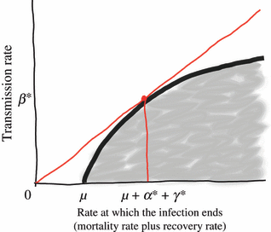
Why do pathogens make us sick?
A virus will evolve to maximize its capacity for between-host infections (R₀).
$$α$$
virulence
As a result, we predict the evolution of “optimal virulence.”
$$β$$
transmission
$β$, transmission
Mechanisms that promote transmission may also enhance virulence to the host.
$α$, virulence + $μ$, nat. mort.
infections created
$$R_{0}=\frac{β(virus density)}{γ+ μ+α(virus density)}$$
Alizon et al. 2008. J Evolutionary Biology
Anderson and May 1982. Parasitology.
infections lost
Notes:
Typically, we predict that a virus will evolve traits that maximize its capacity for reproducing itself by infecting new hosts, achieving a baseline viral density within a single individual that produces sufficient virions in excretia – like the cough shown here – to go on to infect new hosts

Slide 35
Why do pathogens make us sick?
A virus will evolve to maximize its capacity for between-host infections (R₀).
$$α$$
virulence
As a result, we predict the evolution of “optimal virulence.”
$$β$$
transmission
$β$, transmission
Note that originally Anderson and May (1982) represented this link to virus density as acting on the disease recovery rate, though it is now more commonly expressed as a function of virulence!
Mechanisms that promote transmission may also enhance virulence to the host.
$α$, virulence + $μ$, nat. mort.
infections created
$$R_{0}=\frac{β(virus density)}{γ+ μ+α(virus density)}$$
Alizon et al. 2008. J Evolutionary Biology
Anderson and May 1982. Parasitology.
infections lost
Notes:
Typically, we predict that a virus will evolve traits that maximize its capacity for reproducing itself by infecting new hosts, achieving a baseline viral density within a single individual that produces sufficient virions in excretia – like the cough shown here – to go on to infect new hosts

Slide 36
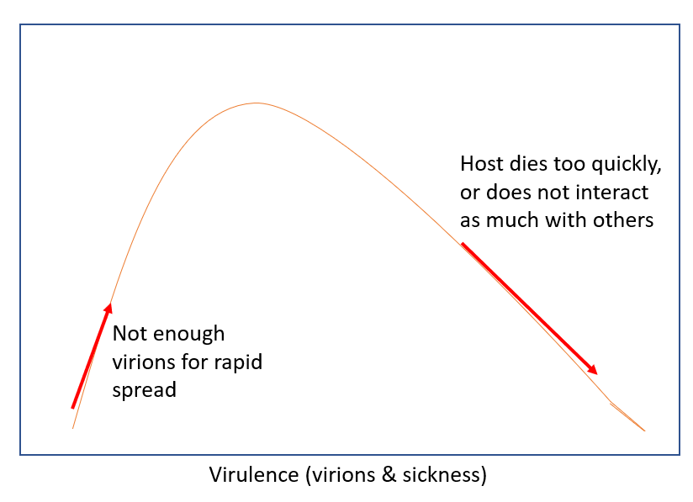

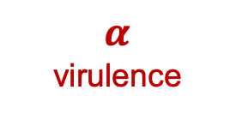

Why do pathogens make us sick?
A virus will evolve to maximize its capacity for between-host infections (R₀).
As a result, we predict the evolution of “optimal virulence.”
$$α$$
virulence
$$β$$
transmission
$$R_{0}$$
Mechanisms that promote transmission may also enhance virulence to the host.
Alizon et al. 2008. J Evolutionary Biology
Anderson and May 1982. Parasitology.
Notes:
Typically, we predict that a virus will evolve traits that maximize its capacity for reproducing itself by infecting new hosts, achieving a baseline viral density within a single individual that produces sufficient virions in excretia – like the cough shown here – to go on to infect new hosts

Slide 37
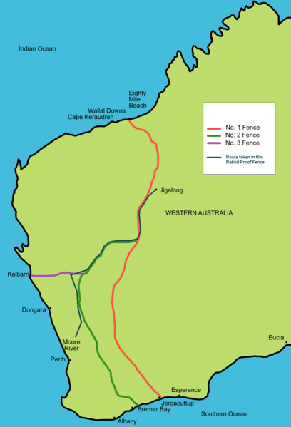
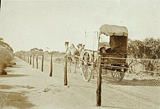
The virulence case study of rabbit Myxoma virus
1788: European rabbits brought to Australia as a food source
Rabbits quickly became feral and numbers soared.
1901: Australia constructed the famous “rabbit-proof fence” to attempt to keep rabbits out of agriculture in the West
Government looked to control measures, including biological controls in the 1930s.
Tried Myxoma virus, a highly virulent European poxvirus infecting rabbits. with a CFR >99%

Slide 38
The virulence case study of rabbit Myxoma virus
1788: European rabbits brought to Australia as a food source
Rabbits quickly became feral and numbers soared.
1901: Australia constructed the famous “rabbit-proof fence” to attempt to keep rabbits out of agriculture in the West.
Government looked to control measures, including biological controls in the 1930s.
Tried Myxoma virus, a highly virulent European poxvirus infecting rabbits. with a CFR >99%

Slide 39
The virulence case study of rabbit Myxoma virus
1788: European rabbits brought to Australia as a food source
Rabbits quickly became feral and numbers soared.
1901: Australia constructed the famous “rabbit-proof fence” to attempt to keep rabbits out of agriculture in the West.
Government looked to control measures, including biological controls in the 1930s.
Tried Myxoma virus, a highly virulent European poxvirus infecting rabbits. with a CFR >99%.

Slide 40
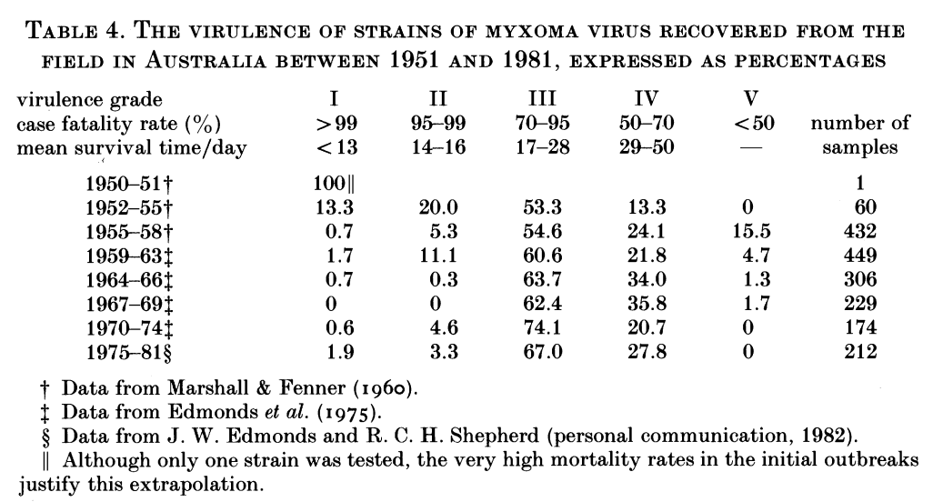
Myxoma virus evolved to intermediate virulence in just a single year.
Fenner 1983. Proc Roy Soc B

Slide 41
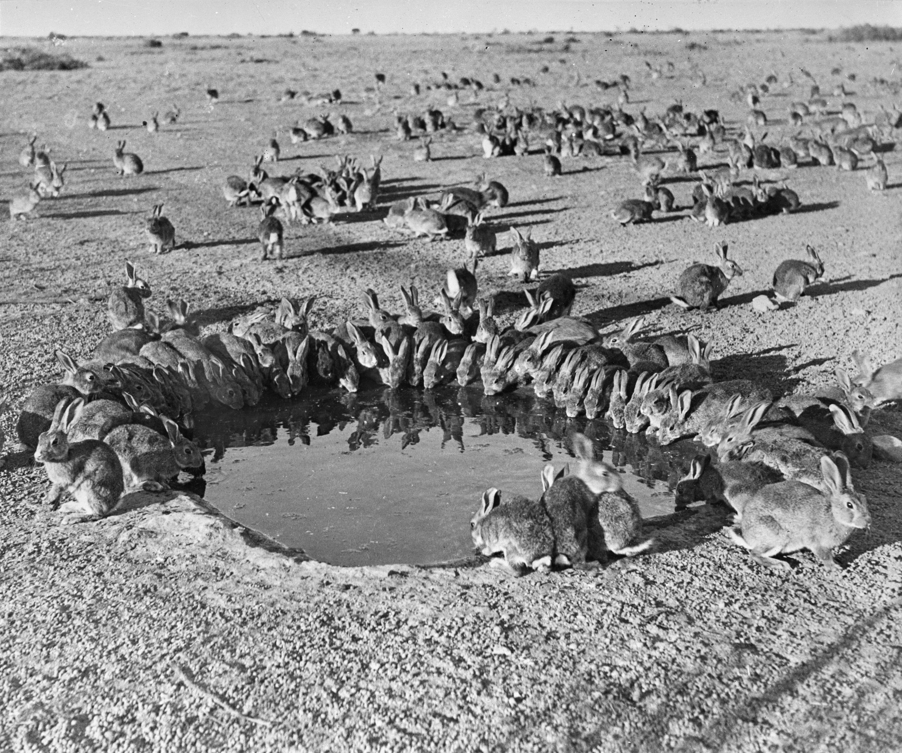
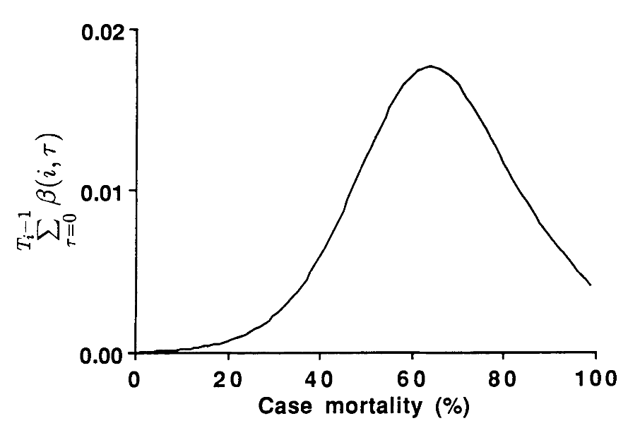
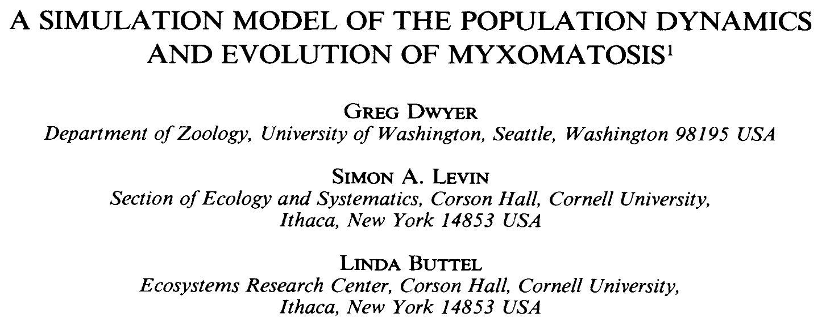
For Myxoma virus, intermediate virulence evolution resulted from optimization of the tradeoffs between virulence and transmission.
Cumulative transmission function, similar to R₀
Rabbits around a waterhole in the myxomatosis trial site on Wardang Island, Australia, 1938
Dwyer, Levin, and Buttel. 1990.
Ecological Monographs.

Slide 42
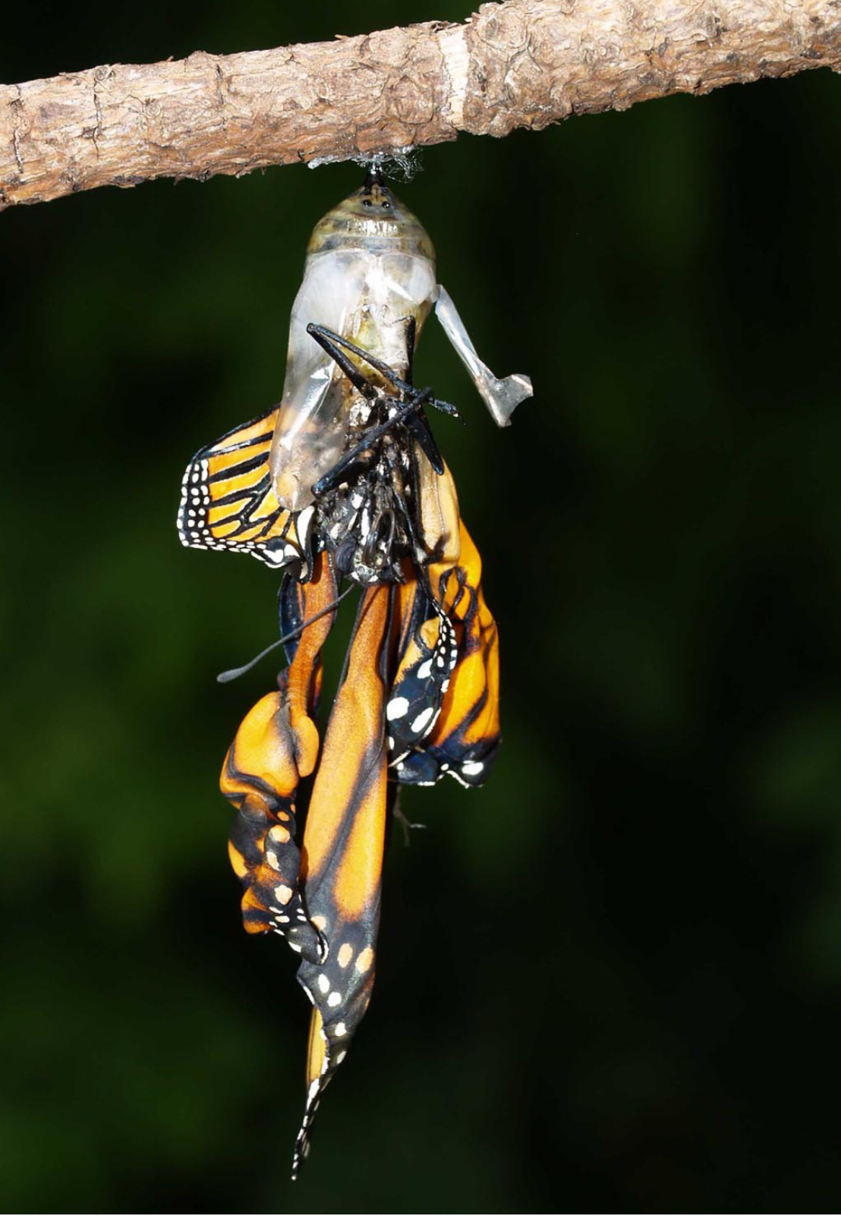
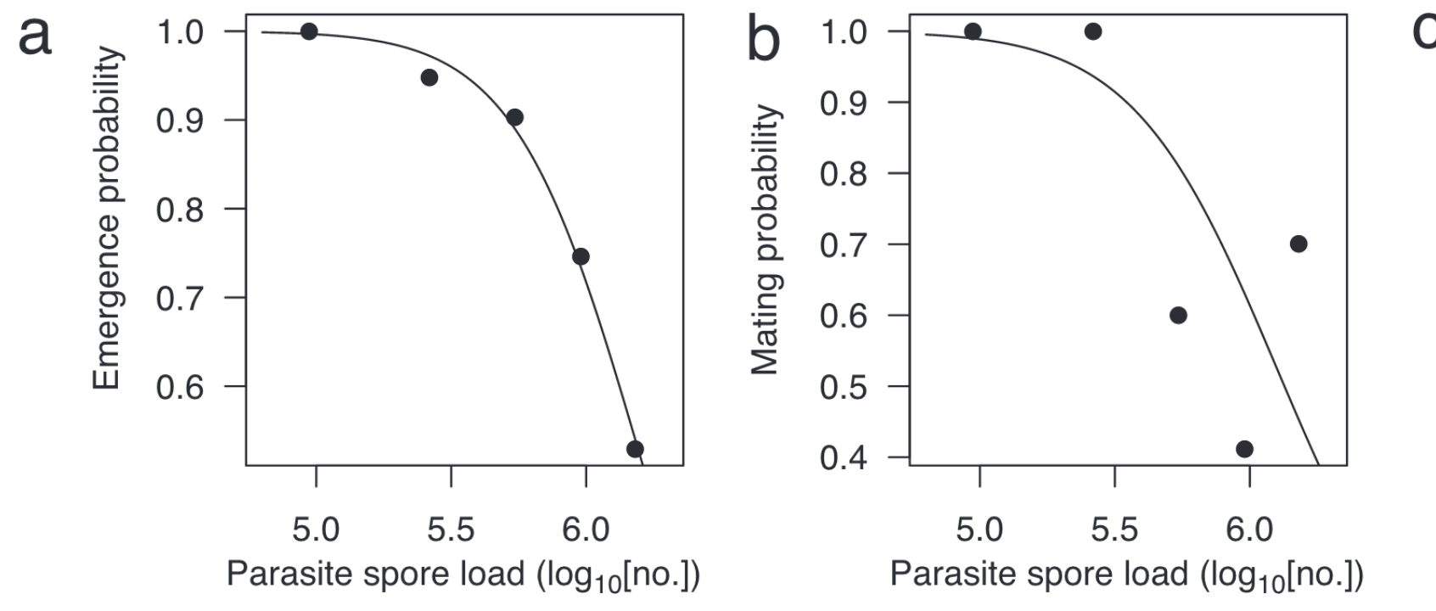
Another classic transmission-virulence tradeoff: parasites of monarch butterflies
Monarch butterflies infected with the protozoan parasite, Ophryocystis elektroscirrha, demonstrate reduced emergence and mating probabilities at higher parasite spore load (virulence).
de Roode et al. 2008. PNAS.

Slide 43
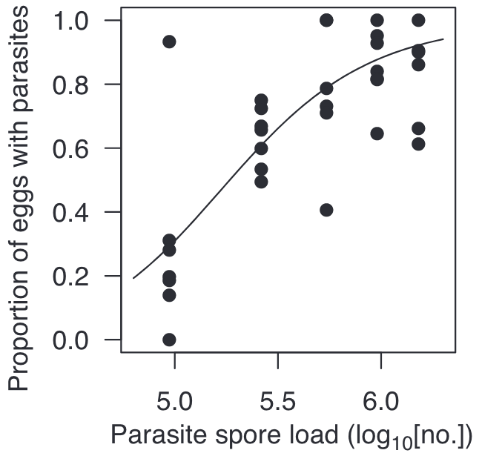
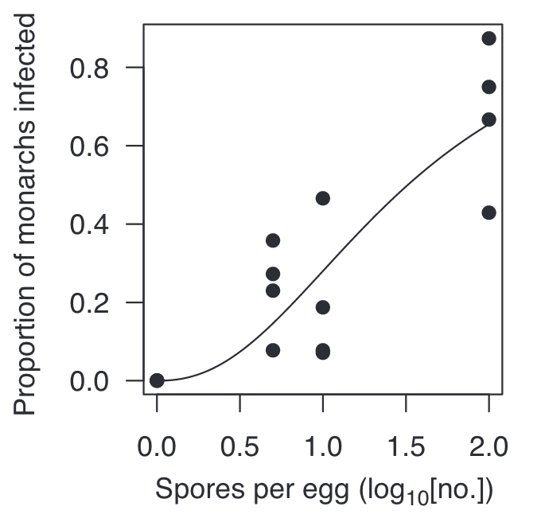
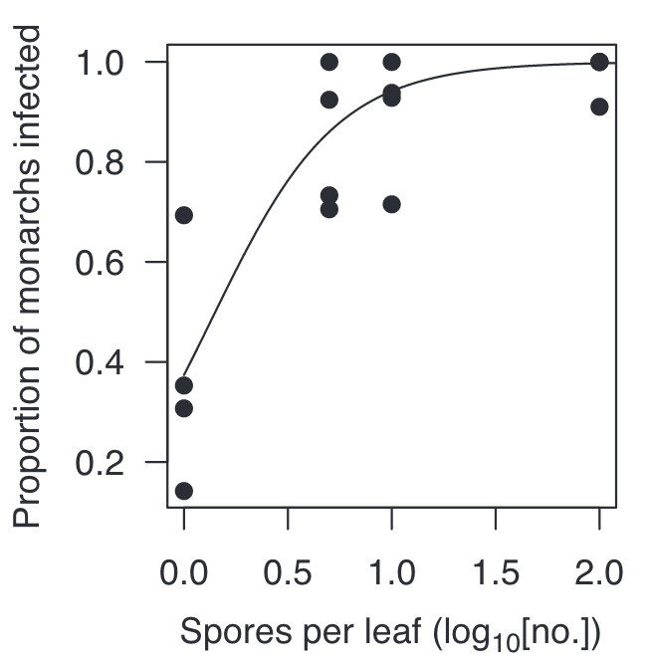
Another classic transmission-virulence tradeoff: parasites of monarch butterflies
Monarch butterflies infected with the protozoan parasite, Ophryocystis elektroscirrha, demonstrate reduced emergence and mating probabilities at higher parasite spore load (virulence).
On the flip side, higher parasite loads also led to increased transmission through higher proportions of monarch eggs that acquired spores and higher numbers of parasites per egg and milkweed leaf, which increased the probability of infection.
de Roode et al. 2008. PNAS.

Slide 44
Another classic transmission-virulence tradeoff: parasites of monarch butterflies
Monarch butterflies infected with the protozoan parasite, Ophryocystis elektroscirrha, demonstrate reduced emergence and mating probabilities at higher parasite spore load (virulence).
On the flip side, higher parasite loads also led to increased transmission through higher proportions of monarch eggs that acquired spores and higher numbers of parasites per egg and milkweed leaf, which increased the probability of infection.
Parasite fitness is calculated to be maximized at intermediate spore load.
$β$, transmission
$α$, virulence + $μ$, nat. mort.
de Roode et al. 2008. PNAS.

Slide 45
Limitations of the tradeoff model
The ‘trade-off hypothesis’ offers an explanation for the disease inflicted by parasites and pathogens on their original hosts. While well-designed theoretically, it has not been historically well-supported empirically!
This is partly due to challenges arising from the difficulty of measuring (and defining) transmission and virulence.
Virulence is a fitness cost that the parasite inflicts on the host, but these can take diverse forms, with differing consequences for the evolution of virulence.
(e.g. fitness effects on reproduction vs. adult mortality)
Sometimes, virulence is the result of the host’s immune response, rather than the direct impact of the parasite itself, further complicating dynamics
In the case of zoonoses, the bulk of our measurements may be derived from a different host than the one in which the virus evolved
Many examples of cases in which transmission is decoupled from virulence, due to more complex transmission dynamics.
Ex: Ebola (transmission after death )
Ex: COVID (transmission high in the respiratory tract; morbidity low in the RT)

Slide 46
Limitations of the tradeoff model
The ‘trade-off hypothesis’ offers an explanation for the disease inflicted by parasites and pathogens on their original hosts. While well-designed theoretically, it has not been historically well-supported empirically!
This is partly due to challenges arising from the difficulty of measuring (and defining) transmission and virulence.
Virulence is a fitness cost that the parasite inflicts on the host, but these can take diverse forms, with differing consequences for the evolution of virulence.
For example: Fitness effects on reproduction vs. adult mortality
Sometimes, virulence is the result of the host’s immune response, rather than the direct impact of the parasite itself, further complicating dynamics
In the case of zoonoses, the bulk of our measurements may be derived from a different host than the one in which the virus evolved
Many examples of cases in which transmission is decoupled from virulence, due to more complex transmission dynamics.
Ex: Ebola (transmission after death )
Ex: COVID (transmission high in the respiratory tract; morbidity low in the RT)

Slide 47
Limitations of the tradeoff model
The ‘trade-off hypothesis’ offers an explanation for the disease inflicted by parasites and pathogens on their original hosts. While well-designed theoretically, it has not been historically well-supported empirically!
This is partly due to challenges arising from the difficulty of measuring (and defining) transmission and virulence.
Virulence is a fitness cost that the parasite inflicts on the host, but these can take diverse forms, with differing consequences for the evolution of virulence.
For example: Fitness effects on reproduction vs. adult mortality
Sometimes, virulence is the result of the host’s immune response, rather than the direct impact of the parasite itself, further complicating dynamics
In the case of zoonoses, the bulk of our measurements may be derived from a different host than the one in which the virus evolved
Many examples of cases in which transmission is decoupled from virulence, due to more complex transmission dynamics.
Ex: Ebola (transmission after death )
Ex: COVID (transmission high in the respiratory tract; morbidity low in the RT)

Slide 48
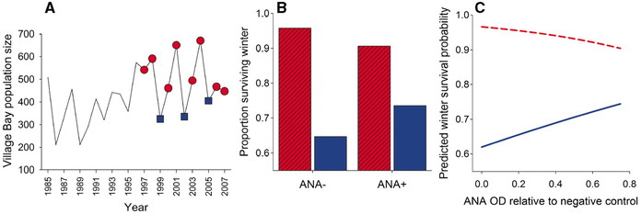
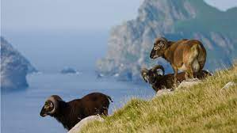
Sometimes, virulence is the result of the host’s immune response, rather than the direct impact of the parasite itself
Self-reactive antibodies (ANA) promote survival by downregulating worms in crash years but impede survival via immunopathology in peak years!
Graham et al. 2010. Science.

Slide 49
Sometimes, virulence is the result of the host’s immune response, rather than the direct impact of the parasite itself
In good weather
years, higher ANA leads to lower survival probability
good weather years
poor weather years
Self-reactive antibodies (ANA) promote survival by downregulating worms in crash years but impede survival via immunopathology in peak years!
In poor weather years, higher ANA leads to higher survival probability
Graham et al. 2010. Science.

Slide 50
Limitations of the tradeoff model
The ‘trade-off hypothesis’ offers an explanation for the disease inflicted by parasites and pathogens on their original hosts. While well-designed theoretically, it has not been historically well-supported empirically!
This is partly due to challenges arising from the difficulty of measuring (and defining) transmission and virulence.
Virulence is a fitness cost that the parasite inflicts on the host, but these can take diverse forms, with differing consequences for the evolution of virulence.
For example: Fitness effects on reproduction vs. adult mortality
Sometimes, virulence is the result of the host’s immune response, rather than the direct impact of the parasite itself, further complicating dynamics
In the case of zoonoses, the bulk of our measurements may be derived from a different host than the one in which the virus evolved
Many examples of cases in which transmission is decoupled from virulence, due to more complex transmission dynamics.
Ex: Ebola (transmission after death )
Ex: COVID (transmission high in the respiratory tract; morbidity low in the RT)

Slide 51
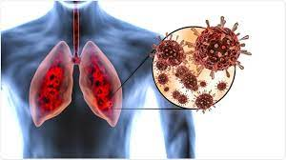
Limitations of the tradeoff model
The ‘trade-off hypothesis’ offers an explanation for the disease inflicted by parasites and pathogens on their original hosts. While well-designed theoretically, it has not been historically well-supported empirically!
This is partly due to challenges arising from the difficulty of measuring (and defining) transmission and virulence.
Virulence is a fitness cost that the parasite inflicts on the host, but these can take diverse forms, with differing consequences for the evolution of virulence.
For example: Fitness effects on reproduction vs. adult mortality
Sometimes, virulence is the result of the host’s immune response, rather than the direct impact of the parasite itself, further complicating dynamics
In the case of zoonoses, the bulk of our measurements may be derived from a different host than the one in which the virus evolved
Many examples of cases in which transmission is decoupled from virulence, due to more complex transmission dynamics.
Ex: COVID (transmission high in the respiratory tract; morbidity low in the RT)

Slide 52


Slide 53
Disease dynamics in the broader community

Slide 54
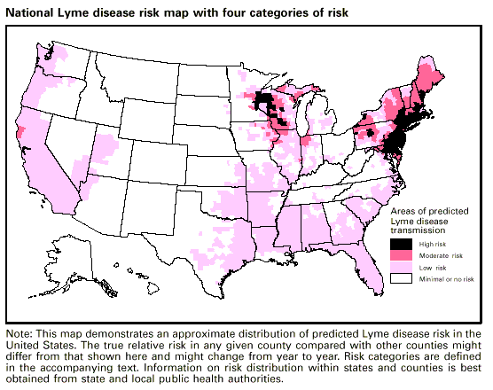
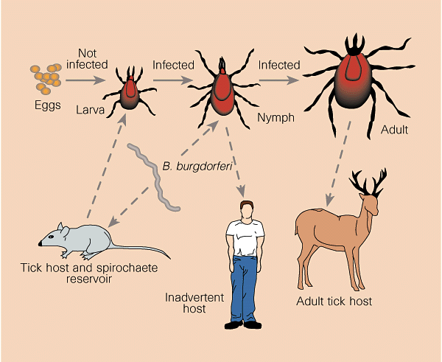
Disease dynamics in the broader community
Example: Lyme Disease
Lyme disease is a vector-borne disease caused by the bacterium, Borrellia burgdoferi, vectored by Ixodes especially Ixodes scapularis) ticks.
Nymph ticks are borne in the spring, feed on small mammal hosts through the summer, then reproduce (particularly on deer) in the fall before going dormant in the winter.
Human cases are largely concentrated in the spring and summer and result from infected tick bites.
Barbour and Zuckert 1997. Nature.

Slide 55
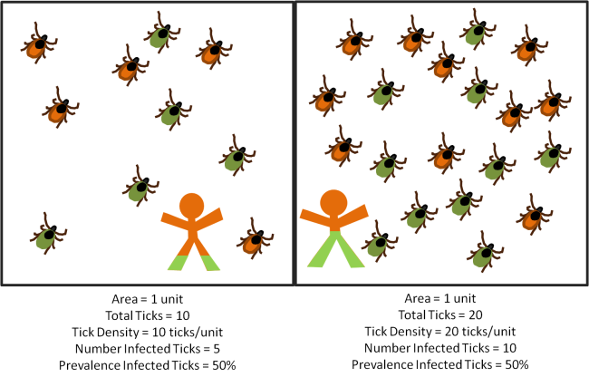
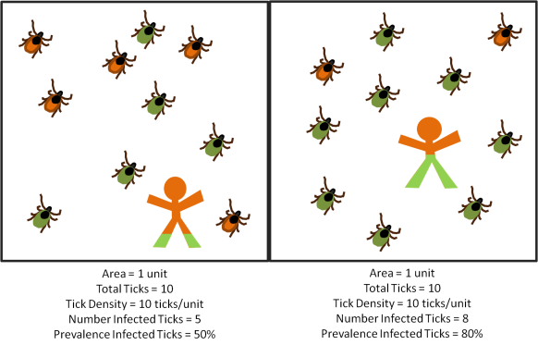
Human infection probability varies with both the density of infected ticks and the prevalence of Lyme in the tick population.
Scenario 1: Density of infected ticks
Scenario 2: Prevalence of Lyme in tick population
lime = infected with Lyme
parasiteecology.wordpress.com

Slide 56
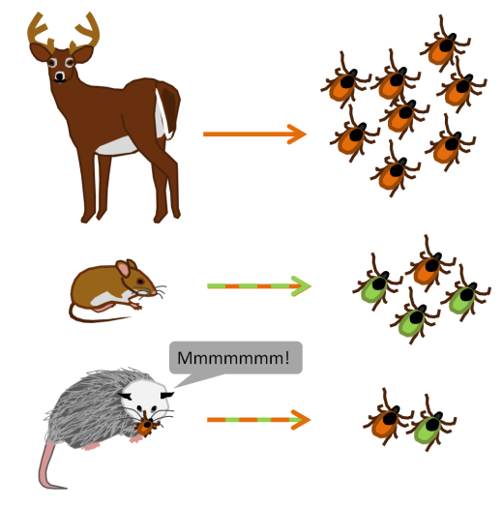
The broader wildlife community impacts Lyme disease risk for humans
Wildlife hosts vary in the extent to which they offer blood meals to ticks, thereby modulating tick abundance.
Wildlife hosts also vary in their permissibility to B. burgdoferi infection.
lime = infected with Lyme
parasiteecology.wordpress.com

Slide 57
The dilution effect highlights buffering effects of biodiversity on disease transmission.
While a popular concept, it only holds in select cases!

Slide 58

The dilution effect highlights buffering effects of biodiversity on disease transmission.
While a popular concept, it only holds in select cases!
In the case of Lyme, many examples demonstrate a
negative correlation between host biodiversity and Lyme prevalence.
Ostfeld and Keesing. 2000. Conservation Biology.

Slide 59
The dilution effect highlights buffering effects of biodiversity on disease transmission.
While a popular concept, it only holds in select cases!
In the case of Lyme, many examples demonstrate a
negative correlation between host biodiversity and Lyme prevalence.
Patterns depend on the context of the wildlife community!

Slide 60

Human infection probability varies with both the density of infected ticks and the prevalence of Lyme in the tick population.
parasiteecology.wordpress.com

Slide 61


“Zooprophylaxis” is the diversion of pathogen-transmitting arthropods from humans to animals
Tick burden on woodrats in Marin County, CA following removal of western fence lizard (Sceloporus occidentalis) at the end of the 2007 year in experimental (solid) and control (open circle) plots
lizard removal
Sceloporus occidentalis
Swei et al. 2011. Proc Roy Soc B.

Slide 62


“Zooprophylaxis” has been suggested for malaria control – but only works in cases by which livestock are used as bait to draw mosquitoes closer to insecticides.
Black, red, green, blue = 0, 20, 40 or 60% chance of mosquito being killed as a result of feeding on animals
Asale et al. 2017. Malaria Journal

Slide 63


Understanding the underlying transmission dynamics of the system can help predict how wildlife biodiversity might amplify or dilute human disease risk in different contexts.
Results from an extended Ross-McDonald malaria model
Meta-analysis of biodiversity impacts on 69 common human pathogens
amplification
spurious dilution
true dilution
disease eradication
Wood et al. 2014. Ecology

Slide 65
Extra

Slide 66


Spatial structuring generally favors reduced pathogen virulence.
Boots and Sasaki. 1999. Proc Roy Soc B.

Slide 67


Imperfect vaccination can support the evolution of higher virulence, depending on the lifestage of the pathogen that is targeted.
Malaria vaccines
anti-growth rate vaccines
transmission-blocking vaccines
infection blocking vaccines
transmission-blocking vaccines
infection blocking vaccines
anti-growth rate vaccines
Gandon et al. 2001. Nature.

